Slide 1
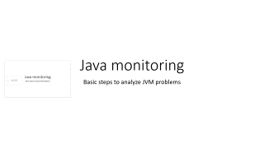

Java monitoring
Basic steps to analyze JVM problems

Slide 2
Agenda
Heap status with jstat
Take a thread dump using jstack
Heapdump
Java Mission Control with Jboss
JConsole with Jboss

Slide 3
Check java heap with jstat
/opt/jdk1.8/bin/jstat -gcutil <pid> as jboss runtime user
S0 S1 E O P YGC YGCT FGC FGCT GCT
0.00 6.91 93.60 11.50 15.55 13 0.948 0 0.000 0.948
Eden
Survivor 1
Survivor 2
Old generation
FGC
/opt/jdk1.8/bin/jstat -gcmetacapacity <pid>
MCMN MCMX MC CCSMN CCSMX CCSC YGC FGC FGCT GCT
0.0 1501184.0 508928.0 0.0 1048576.0 57344.0 83 1 4.319 18.288
MCMN: Minimum metaspace capacity (kB).
MCMX: Maximum metaspace capacity (kB).
MC: Metaspace capacity (kB).
-> MetaSpace was introduced with JDK 1.8

Slide 4
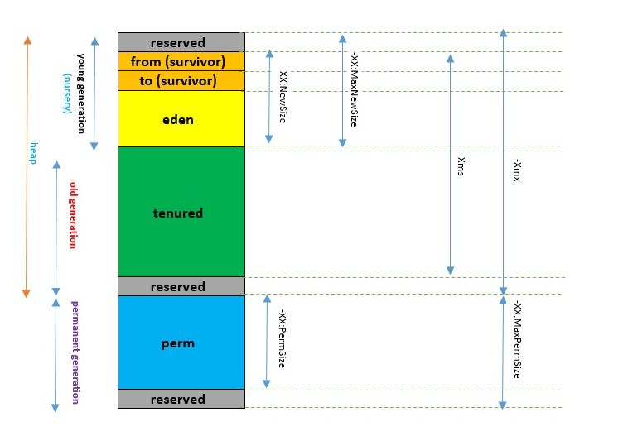
Java Memory Model (before JDK 1.8) http://abhinawtripathi34.wixsite.com/abhinawtripathi/single-post/2017/05/30/Java-Memory-Architecture-and-Garbage-Collection-AlgorithmsPart-1

Slide 5
Check java threads with jstack
/opt/jdk1.8/bin/jstack <pid> > /tmp/vtszgjj01_uszgjplap1.thread.dump.2019-09-26_09.31
The file could be read directly but it‘s better to analyze it with a thread dump analyzer like JVM Thread Analyzer "C:\Program Files\Java\jdk-11.0.2\bin\java.exe" -jar "C:\tmp\IBM Thread Analyzer\jca461.jar"

Slide 6
Take a java heap dump
Be careful: The java heap dump blocks the full JVM !
/opt/jdk1.8/bin/jmap -dump:format=b,file=<file name> <pid>
The java heap dump can have the size of gigabytes. Keep this in mind for the filesystem of the output file.
The heap dump should be analyzed by the development team.

Slide 7
Java Mission Control 1 – prepare the JVM
Add java parameters: -XX:+UnlockCommercialFeatures -XX:+FlightRecorder
Restart the JVM
http://www.oracle.com/technetwork/java/javaseproducts/mission-control/java-mission-control-1998576.html
https://docs.oracle.com/javacomponents/jmc-5-5/jfr-runtime-guide/comline.htm#JFRRT183

Slide 8
Java Mission Control 2 – commands and analysis
export JAVA_HOME=/opt/jdk1.8
export PATH=$JAVA_HOME/bin:$PATH
jcmd <pid> VM.check_commercial_features
jcmd <pid> JFR.start duration=3600s filename=/tmp/uszgjplap1.vtszgjj01.2019-09-30_hh.mm.jfr
jcmd <pid> JFR.stop recording=1
jcmd <pid> JFR.check
Copy the file to your PC and use jmc.exe to view it

Slide 9
JConsole 1 – setup for Jboss
vi mgmt-users.properties, add adminx=b9ba48780c74878bf86238265a222d6a
update standalone.xml -> add user adminx to rbac SuperUser
<role name="SuperUser" include-all="false">
<include>
<user name="$local"/>
<user alias="adminx" name="adminx"/>
<group alias="jknqwradmin" name="jknqwradmin"/>
</include>
Restart Jboss
Tunnel
uszgjqlap1.internal.unicreditgroup.eu
L9999 127.0.0.1:9999

Slide 10
JConsole 2 – start the session
Download Jboss to Y: drive on Citrix
Download Java JDK 1.8 to Y: drive on Citrix
Update jconsole.bat of the Y: drive Jboss
set JAVA_HOME=Y:\jdk1.8.0_144 (path to the Y: drive JDK)
Open the tunnel
Start jconsole.bat of the Y: drive Jboss
Logon information
Remote Processs: service:jmx:remoting-jmx://127.0.0.1:9999
user: adminx
password: Root123+

Slide 11
